Slide 1
Sonoloc: Scalable positioning of commodity mobile devices using audio signals
Viktor Erdélyi, Trung-Kien Le, Bobby Bhattacharjee, Peter Druschel, Nobutaka Ono
Max Planck Institute for Software Systems (MPI-SWS) University of Maryland National Institute of Informatics, Tokyo

Slide 2
Addressing recipients based on relative position
Seated dinner at an event
Auditorium: distributing exams
Alice
Person of interest
Lecturer

Slide 3
Tagging messages with the sender's position
Q&A session
Audiovisual experience feedback
Speaker
Stage or screen
Questioner w/ mic
👍
👍
👎

Slide 4
2D relative position map
Accurate
Scalable to 100s of devices
No local infrastructure
No special hardware
Enable communication: each node is associated with an electronic ID
Challenge: satisfy all constraints at once

Slide 5
State of the art
Requires local infrastructure
Centaur (Nandakumar et al., Mobicom 2012)
Requires special hardware
PinPoint (Youssef et al., MobiSys 2006)
Is not accurate enough to place people into a particular seat
EZ Localization (Chintalapudi et al., MobiCom 2010)
Acoustic signals: at least one beep per device → does not scale
BeepBeep (Peng et al., SenSys 2007)

Slide 6


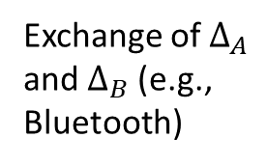
Pairwise distance estimation via BeepBeep (Peng et al., SenSys 2007)
Cannot directly measure time of flight
Cannot assume synchronized clocks
Unknown delays in the audio software stack
$$Δ_{B}$$
Device B
time
Audio chirp
Audio chirp
Exchange of $Δ_{A}$ and $Δ_{B}$ (e.g., Bluetooth)
Device A
$$Δ_{A}$$
$${PropTime}_{A→B}+{PropTime}_{B→A} ≈Δ_{A}−Δ_{B}$$

Slide 7
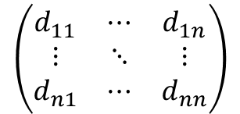
Relative positioning based on pairwise distances
Constraint solving
(Le et al., EUSIPCO 2016)
$$\left(\begin{matrix}d_{11} & ⋯ & d_{1n} \\ ⋮ & ⋱ & ⋮ \\ d_{n1} & ⋯ & d_{nn}\end{matrix}\right)$$
2D relative position map
All pairwise distances
Problem: needs at least one transmission from each participant
Does not scale

Slide 8
Sonoloc

Slide 9
Assumptions
Participants carry a smart device
Within audible distance
Unobstructed line of sight
Stationary devices (during measurement)
Small vertical (Z) offsets (due to 2D loc.)

Slide 10
Key idea: 2 phases
Phase 1
Choose a small subset of devices as audio transmitters
All others are silent
Assign relative coordinates to just the transmitters
Passive device
Transmitter device
Pairwise distance

Slide 11

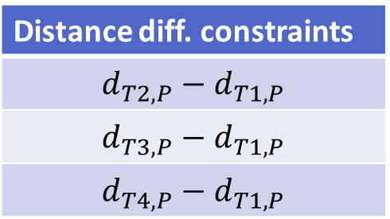



Phase 2: localizing the remaining, passive devices
Distance diff. constraints
$$d_{T2,P}−d_{T1,P}$$
$$d_{T3,P}−d_{T1,P}$$
$$d_{T4,P}−d_{T1,P}$$
Passive devices only listen
T1,T2,P: Time diff. of arrival of 2 signals at all 3 locations → distance difference
$$d_{T1,P}$$
P
Constraint solving
(Stoica et al., IEEE Signal Processing Magazine 2006)
T1
Transmitter positions
$$d_{T2,P}$$
T2
$$d_{T4,P}$$
$$d_{T3,P}$$
Position of P
Passive device
Transmitter device
Distance difference
Pairwise distance
To localize all passive devices: repeat for each
T3
T4

Slide 12
How to choose transmitters?
Poor choices of transmitters
Good choices of transmitters
Intuition: choose on convex hull (based on map)
Accurate position map
Good transmitter choice
Passive device
Transmitter device

Slide 13

Iterative transmitter selection algorithm
Small, random set of transmitters
Position all devices
Choose an additional transmitter: maximize convex hull of transmitters
New transmitter transmits one signal
Go to step 2
Passive device
Transmitter device

Slide 14
Iterative transmitter selection algorithm
Passive device
Transmitter device

Slide 15
Iterative transmitter selection algorithm
Passive device
Transmitter device

Slide 16
Iterative transmitter selection algorithm
Stop at the specified number of transmitters
Passive device
Transmitter device

Slide 17
Evaluation
Simulations and real experiments

Slide 18
Simulations: various device layouts
Random
(quadratic or circular space)
Clustered
Concentric circles
Cafeteria
(36 tables, 4x2 each)
Banquet
(10 round tables, 12 devices each)
Small restaurant
(6 tables, 3x2 each, 30 occupied randomly)
Lecture hall
20 x 20 seats, 100 occupied randomly
Conference room
(15 x 2)
We also simulate signal processing inaccuracy, Z-offsets, temperature influence, sampling rate mismatch

Slide 19
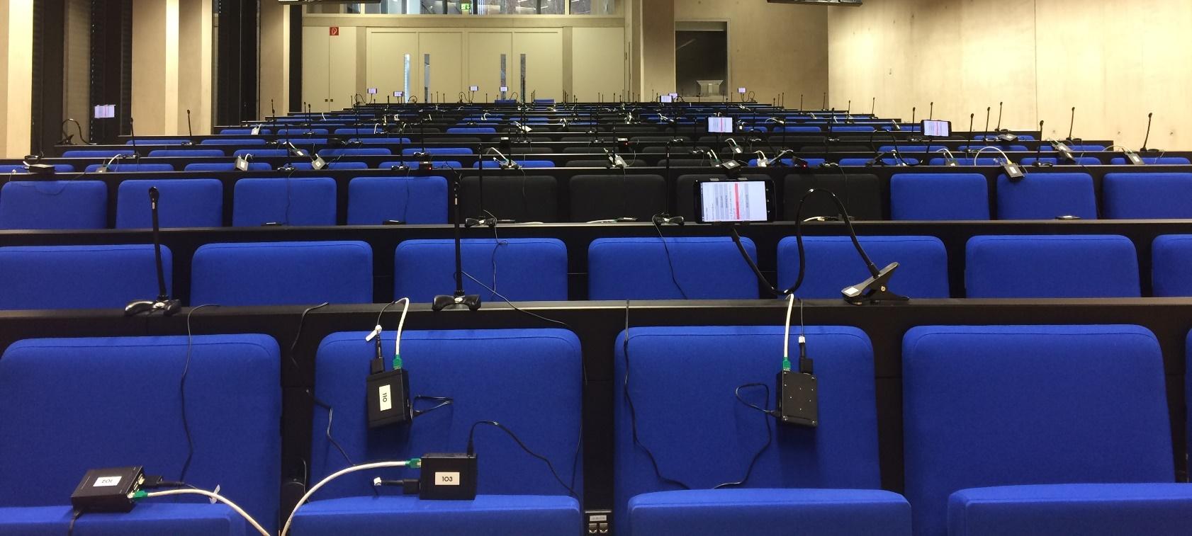
Real-world deployment
Several rooms with different shapes, sizes, acoustic properties
Several background noise types (silent, speech, music)
100 passive devices = 100 microphones+ 100 Raspberry Pis
15 transmitters = 15 smartphones

Slide 20
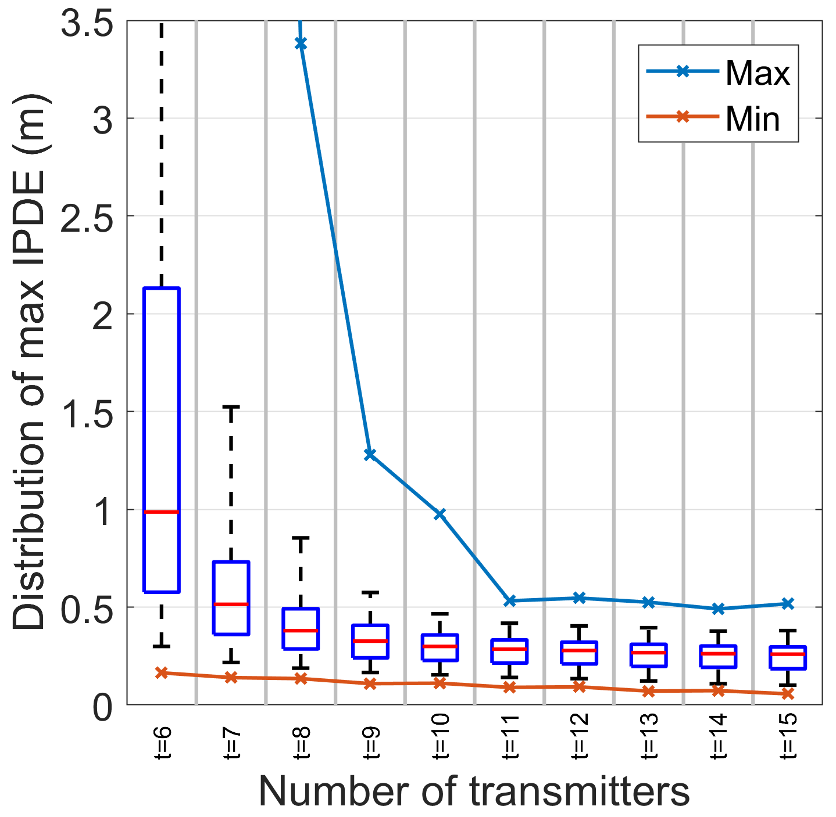
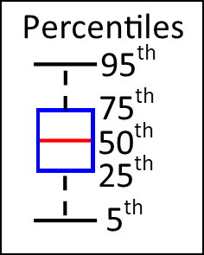
Simulation results (aggregated)
Max IPDE vs. number of transmitters
Evaluation metric: Interpoint distance error (IPDE)
Absolute difference between:
Ground-truth distance
Estimated distance (measured on the output position map)
Main takeaway: ≈0.5m max error at 11 tr.
holds for any number of passive devices
6 9 12 15
Number of transmitters

Slide 21
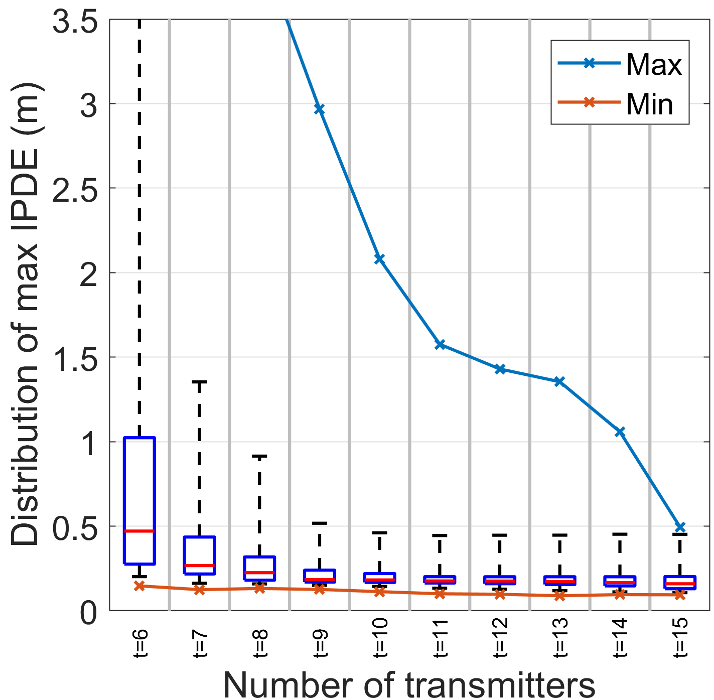
Max IPDE vs. number of transmitters
Simulation (aggregated)
Real experiments (aggregated)
Sound cards & microphones used with Raspberry Pis have lower quality than our phones.
6 9 12 15
Number of transmitters
6 9 12 15
Number of transmitters
≈0.5m max error at 11 tr.
≈0.5m max error at 15 tr.

Slide 22
Summary
Sonoloc: a method to compute a 2D relative position map of smart devices within acoustic range
Can scale to 100s of devices
No local infrastructure needed
Works with commodity hardware
Requires only a constant number of audio signals (15)

